Slide 1
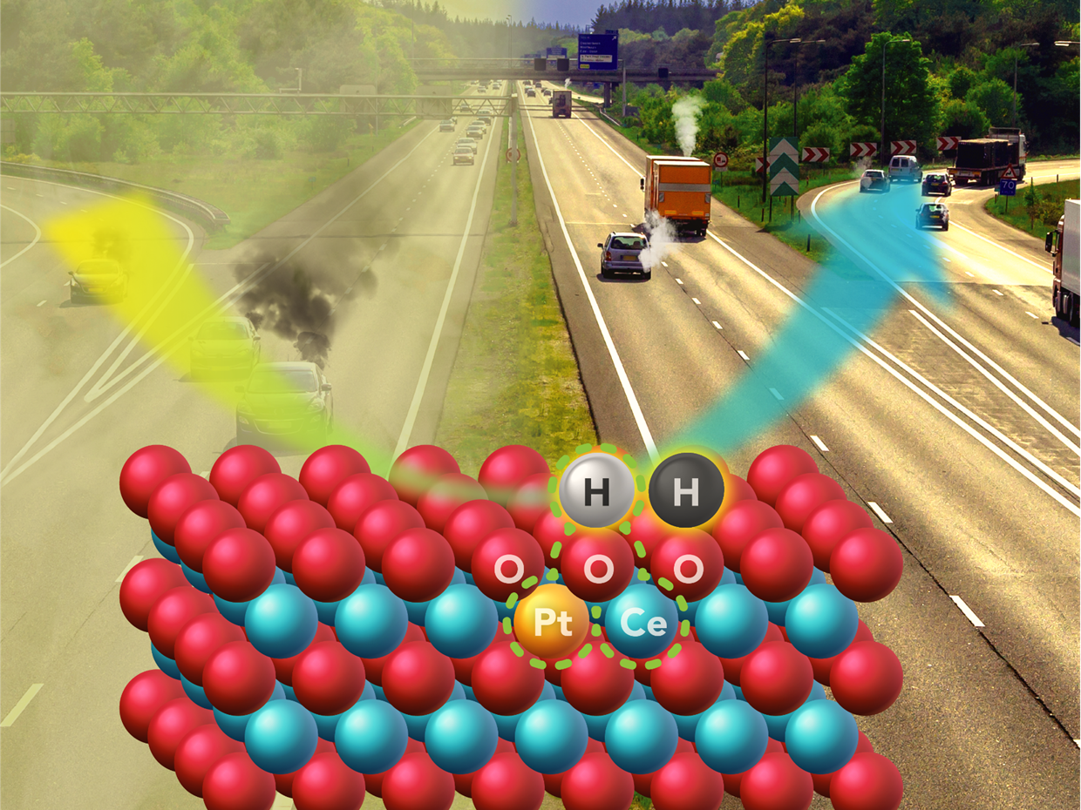



New Catalyst Research Meets Challenge of Cleaning Exhaust from Advanced Engines
Scientific Achievement
Steam treatment of single-atom platinum on ceria at 750°C produces a catalyst with high activity and thermal stability.
Significance and Impact
Significantly improved carbon monoxide conversion was achieved by a novel catalyst based on a new mechanism utilizing oxygen vacancies from steam treatment that comes closer to meeting DOE emissions challenges for both low temperature startup and hot operating conditions.
Research Details
Previous atomically dispersed ionic Pt²⁺ catalysts could not generate enough activated oxygen to react with CO and produce desired CO₂.
Advanced microscopic techniques revealed that steam treatment at 750°C causes oxygen vacancy migration to the ceria surface, generating surface active Olattice[H] in the vicinity of atomically dispersed ionic Pt²⁺.
This activated oxygen reduces CO emissions as well as other criteria pollutants such as NOx and saturated/unsaturated hydrocarbons.
A new type of active site (dashed green circles) meets the dual challenge of achieving high activity and thermal stability in single atom catalysts.
Nie, Datye, Wang, et al., Science, 2017,
DOI: 10.1126/science.aao2109
(Dec. 15, 2017 issue)
Lei Nie, Donghai Mei, Bo Peng, Zhibo Ren, Meng Wang, Mark Engelhard, Libor Kovarik, Yong Wang (PNNL & WSU); Xavier Isidro Perera Hernandez, Haifeng Xiong, Andrew DeLaRiva, Abhaya Datye (UNM)
Notes:
Catalysts have been an integral part of diesel- or gasoline-powered engines since the mid-1970s as federal regulations called for reductions of carbon monoxide, hydrocarbons and nitrogen oxides. Catalytic converters change the pollutants to nitrogen, carbon dioxide and water.
The main challenge is to make a catalyst that could endure engine exhaust temperatures of up to nearly 750 degrees Celsius encountered at high engine loads. Yet, the catalyst could still carry out reactions at temperatures below 150 degrees Celsius during cold start, which is more than 100 degrees Celsius lower than current systems. Increasing fuel efficiency in combustion engines leaves less energy in the tailpipe exhaust, hence lower temperatures are found during operation especially during cold start.
A collaborative effort has created a catalyst capable of reducing pollutants at these lower temperatures. It advances their work, reported in Science in 2016, that demonstrated a way to use small amounts of platinum, a powerful but costly catalyst, and a way to trap and stabilize individual platinum atoms on an irregular surface of cerium oxide. The single-atom catalyst uses platinum more efficiently with excellent thermal stability. For their latest paper, they steam-treated the catalyst at 750 degrees Celsius. This made the single-atom catalyst, which is already thermally stable at high operating temperatures, very active at low temperatures, e.g., <150 degrees Celsius. This demonstration of stability, along with high reactivity, makes it possible to bring single-atom catalysis closer to industrial application.
----------------------------------------
PI: Abhaya Datye (a), Johannes Lercher (b); Yong Wang (c)
Project: (a) DOE/SC/BES, DE-FG02-05ER15712, Sub Nanometer Sized Clusters for Heterogeneous Catalysis
(b) 47319, KC0302010, Low-Temperature Catalytic Routes for Energy Carriers via Spatial and Chemical Organization
(c) DOE/EERE/VTO, CLEERS Aftertreatment Modeling and Analysis
DOE Program Managers: Viviane Schwartz (a,b) and Ken Howden (c)
Publication: Activation of surface lattice oxygen in single-atom Pt/CeO₂ for low-temperature CO oxidation
Lei Nie¹, Donghai Mei¹, Haifeng Xiong², Bo Peng¹, Zhibo Ren¹, Xavier Isidro Pereira Hernandez³, Andrew DeLaRiva², Meng Wang¹, Mark H. Engelhard¹, Libor Kovarik¹, Abhaya Datye¹, Yong Wang^{1,3}
¹Pacific Northwest National Laboratory; ²University of New Mexico; ³Washington State University
dx.doi.org/10.1126/science.aao2109 | Science

