Slide 1
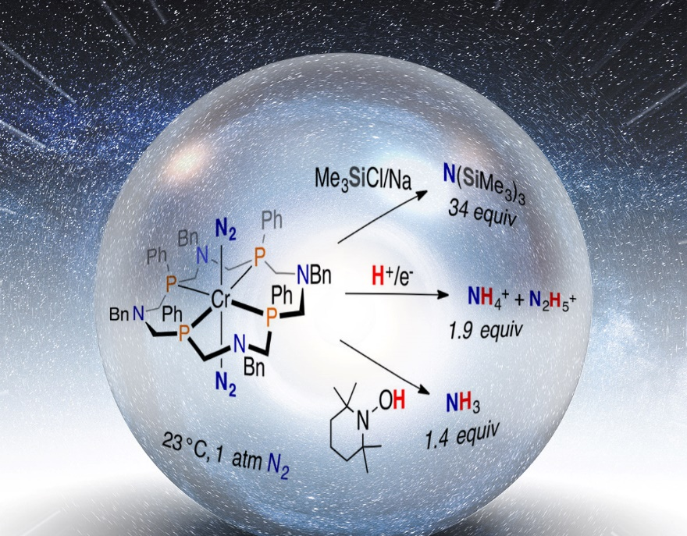
Chromium’s Crowning Achievement: Breaking Dinitrogen’s Triple Bond
Scientific Achievement
Designed the first molecular chromium catalyst for N₂ silylation. The Cr complex also mediates the reduction of N₂ directly to NH₃ gas by two additional pathways.
Significance and Impact
Offers a perspective into how to design highly stable molecular catalysts to mediate N₂ reduction to NH₃; critical to reducing the amount of energy and resources needed to produce NH₃.
Research Details
Cr complex mediates N₂ reduction by three different routes:
Cr performs catalytic silylation and forms N(SiMe₃)₃. This is the first discrete molecular chromium-based catalyst for nitrogen reduction (path 1).
N₂ is converted directly to NH₄⁺ with the addition of protons and electrons. Using protons and electrons could lead to NH₃ production from renewable energy sources and water (path 2).
Gaseous NH₃ is produced directly from a terminally bound N₂ ligand by the net transfer of H atoms using TEMPOH as an H atom donor (path 3).
The Cr-based compound, wrapped in a crown-like phosphorus-based ligand, mediated three reactions that cleaved the triple bond in N₂, all working at room temperature and pressure. Image courtesy of American Chemical Society and Nathan Johnson, Pacific Northwest National Laboratory
Kendall et al.,
J. Am. Chem. Soc. 2018, 140, 2528.
DOI: 10.1021/jacs.7b11132
Alexander J. Kendall, Samantha J. Johnson, R. Morris Bullock, and Michael T. Mock, Center for Molecular Electrocatalysis
Notes:
Turning abundant dinitrogen (two nitrogen atoms joined by a triple bond) into ammonia is vital for synthesizing chemicals and fertilizers, but the traditional reaction requires significant amounts of energy and resources. Creating a more efficient synthesis route means understanding how dinitrogen (N₂) interacts with chromium (Cr) or other transition metals that could serve as potential catalysts. Typically, chromium’s low proclivity to interact with dinitrogen made it a challenging choice. A serendipitous discovery led to the first discrete molecular chromium-based compound for nitrogen reduction. The team produced a 16-membered ring that surrounds the chromium and stabilizes it. The chromium complex mediates the cleavage of the extremely strong dinitrogen triple bond using three different reaction pathways. The first path is catalyzed by chromium, creating a product with silicon-nitrogen bonds that can be easily converted to an ammonia (NH₃) precursor (namely NH₄⁺) by adding acid. The second path and third paths are not catalytic, but dinitrogen is converted directly to NH₄⁺ with the addition of protons and electrons from a chemical reductant. Both the electron source and proton source must be present for the reaction to work. Using protons and electrons delivered by an electrode could lead to simpler ammonia production from renewable energy sources and from water. The third path uses a traditional organic reagent that donates hydrogen atoms and results in the direct production of ammonia gas under ambient conditions. There have been other examples of ammonia formation with hydrogen atom sources, but in all cases the nitrogen-nitrogen triple bond has already been cleaved. This work provides a major insight into mediating the reactivity of nitrogen’s triple bond.
----------------------------------------
PI: Morris Bullock
Project: 56073, KC0307010, EFRC for Center for Molecular Electrocatalysis
DOE Program Manager: Christopher Fecko
Publication: Catalytic Silylation of N₂ and Synthesis of NH₃ and N₂H₄ by Net Hydrogen Atom Transfer Reactions Using a Chromium P₄ Macrocycle
Alexander J. Kendall, Samantha J. Johnson, R. Morris Bullock, and Michael T. Mock, Pacific Northwest National Laboratory
dx.doi.org/10.1021/jacs.7b11132 | Journal of the American Chemical Society

