Slide 1
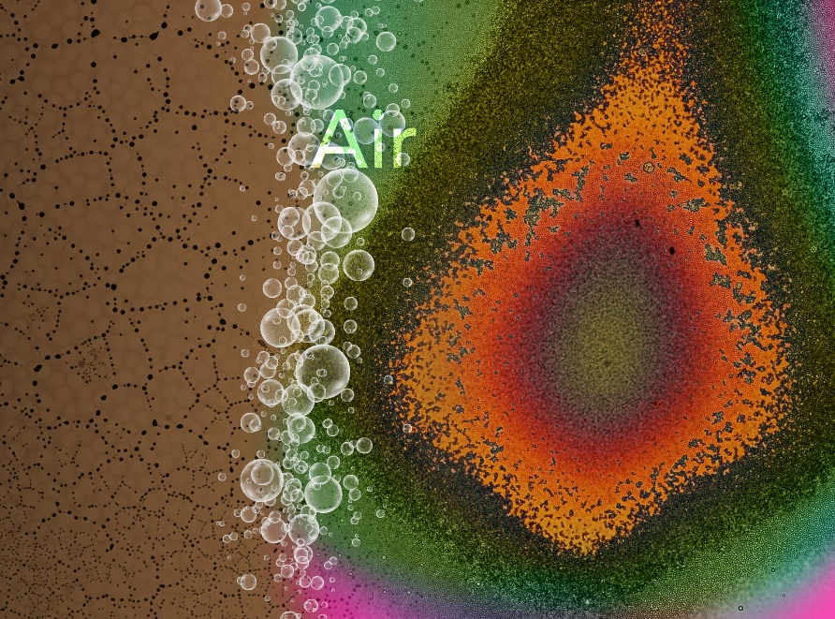
An Intricate Dance of Ions Results in a New Material
Scientific Achievement
Precisely controlled ion chemistry and physics create a never-before-seen material with tunable self-organization and attendant varied optical properties
Significance and Impact
Illustrates how to control molecular properties to create desirable macroscopic structures; such techniques could benefit future material development for separations, sensors, and energy storage
Research Details
Created a liquid-like material with boron and halide containing anions by deposition, via soft landing, onto a substrate and accumulation of neutral molecules from the gas phase
When exposed to air, the material self-organized into droplets
The droplets exhibited different optical properties, based on the halide used and the amount of time they are exposed to the atmosphere
Scientists built a first-of-its-kind material by stacking up layers of negatively charged ions (anions, left). When exposed to air, the liquid-like material crumbles into droplets that reflect light depending on the properties of the deposited anions (right).
Warneke et al.,
Nature Communications, 2018, DOI: 10.1038/s41467-018-04228-2
J Warneke, M McBriarty, S Riechers, S China, M Engelhard, E Apra, R Young, Washton, and G Johnson, PNNL; C Jenne, Bergische Universität Wuppertal; J Laskin, Purdue U
Notes:
The salt crust at the edge of the Dead Sea is just one typical ionic material that involves the accumulation of positively and negatively charged ions. Here, a team led by Jonas Warneke, a fellow visiting Pacific Northwest National Laboratory, investigated the phenomena that occur if large amounts of negative ions (anions) alone are accumulated on a surface. Using ion soft landing, they deposited layers of highly stable model ions (containing boron and a halide) on a surface. The team’s analysis revealed that the anions acquired molecules from the gas phase environment of their instrument. They later controlled the type of accumulated molecule and used it to influence the material’s properties, which also strongly depend on the ion. Also, the team found that when exposed to air, the liquid-like material crumbles and forms droplets — a process relevant to many applications — and scatters light during and after this process. This study offers not only insight into a new material but also ways to control its shape and size.
----------------------------------------
PI: Grant Johnson
Project: 47327, Separations and Analysis in Complex Systems
DOE Program Manager: Philip Wilk
Publication: Self-organizing layers from complex molecular anions
Jonas Warneke, Martin McBriarty, Shawn Riechers, Swarup China, Mark Engelhard, Edorardo Apra, Robert Young, Nancy Washton, and Grant Johnson, Pacific Northwest National Laboratory; Carsten Jenne, Bergische Universität Wuppertal; Julia Laskin, Purdue University
dx.doi.org/10.1038/s41467-018-04228-2 | Nature Communications

