Slide 1
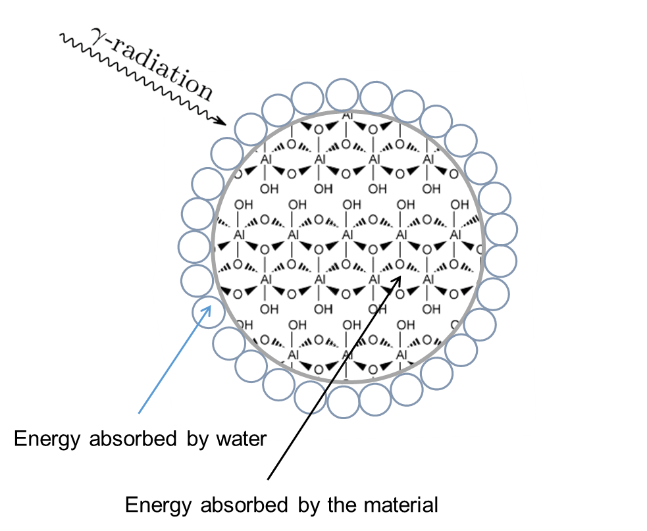






Radiolytic Stability of Gibbsite and Boehmite Nanoparticles
Scientific Achievement
  Surprisingly, irradiated gibbsite (Al(OH)₃) and boehmite (AlO(OH)) nanoparticles with adsorbed water show Al reduction and O displacement from radiolysis at their surfaces, compared to the expected result of little radiation damage to the bulk material.
Significance and Impact
  The Hanford waste tanks contain significant amounts of Al oxyhydroxides that have been exposed for decades to large
  doses of ionizing radiation. Knowledge on radiation induced modification is necessary to facilitate their dissolution and removal from the waste tanks.
Research Details
Bulk interrogation by X-ray diffraction and Raman spectroscopy show no variation due to radiolysis by gamma rays up to 2 MGy.
X-ray photoelectron spectroscopy shows surface reduction of aluminum to the metal and the formation of non-stoichiometric oxygen by radiolysis.
Huestis, Pearce, Zhang, N’Diaye, Rosso, LaVerne DOI: 10.1016/j.jnucmat.2018.01.043
Scanning electron microscope image of gibbsite.
EFRC: IDREAM
Notes:
A significant component of the radioactive wastes at Hanford is aluminum, which exists in the highly alkaline matrices as aluminum oxides and hydroxides, such as gibbsite (Al(OH)₃) and boehmite (AlO(OH)). These solids must be removed along with the radioactive contaminants. They are often finely divided nanoparticulates that are surprisingly more refractory than macrocrystalline gibbsite and boehmite, and are entrained in process streams as slurries that can exhibit peculiar rheological behavior. Such unexpected characteristics present risks when trying to design processing flow sheets of highly radioactive materials. The IDREAM EFRC is investigating the radiolytic stability of Al oxides and oxyhydroxides, where the radiolysis effects at the solid-water interface can be distinguished from radiation damage to the bulk material.
In this study, gibbsite and boehmite were irradiated to 2 MGy using gamma rays and to 175 MGy with alpha particles (separately) at Notre Dame. In each case, comparison of EXAFS and Raman data (which are sensitive to the bulk structure) for pristine and irradiated samples showed little difference. To further study these samples, we used XPS and total electron yield (TEY) XANES, which are surface sensitive techniques. In these cases, evidence for surface-specific changes were revealed for samples irradiated with alpha particles, but not gamma rays. XPS of gibbsite and boehmite indicated reduction of the surface Al(III) to Al metal as well as the formation of non-stoichiometric oxygen when irradiated with alpha particles. Al K-edge TEY-XANES for the materials revealed formation of oxygen centered defects. These results are probably due to loss of hydrogen from the OH groups and rearrangement of the remaining atoms. The surface appears to be sensitive to radiolysis with little effect on the bulk material. For engineers who are attempting to remove the high level radioactive wastes from tanks, these results confirm the necessity of considering both the unexpected chemistry and physics at the solid-water interface, as well as the bulk solubility of the aluminum phases.
This majority of this work was completed at the Notre Dame Radiation Laboratory, and supported by IDREAM (Interfacial Dynamics in Radioactive Environments and Materials), an Energy Frontier Research Center funded by the U.S. Department of Energy, Office of Science, Office of Basic Energy Sciences (BES). X-ray absorption data were collected on Beamline 6.3.1.1 at the Advanced Light Source (Berkeley, CA), gamma radiolysis was performed at the Notre Dame Radiation Laboratory which is supported by the U.S. Department of Energy, Office of Science, BES, and alpha radiolysis was performed at the Notre Dame Nuclear Science Laboratory which is supported by the National Science Foundation.

