Slide 1
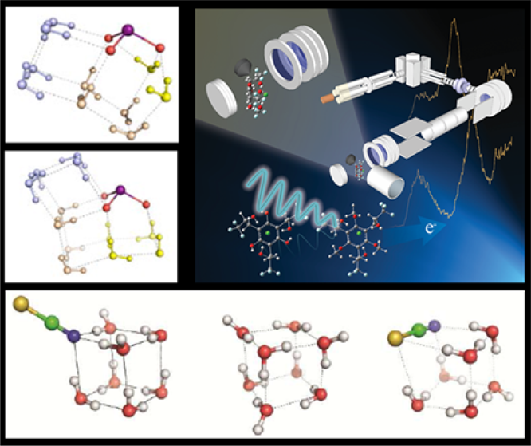
When Ions Cluster
Scientific Achievement
Developed a new approach to bring ions together in clusters to discover their properties and better predict their behavior.
Significance and Impact
Cluster modeling represents an ideal way to model larger scale biological and human-made systems because ion clusters mimic chemical and physical processes in a way current modeling cannot. The work could help explain why some molecules form solids in gases, like pollutants in the atmosphere.
Research Details
-- Used electrospray ionization to create an aerosol of a simple solution of known chemicals.
-- Captured similar molecules and cooled them in an ion trap.
-- Studied using negative ion photoelectron spectroscopy.
-- Tested approach on studies ranging from biological functions to atmospheric chemistry.
-- Discovered that how a cluster behaved determined an ion’s role in a solution, as a solid, and at an interface.
PNNL’s new approach to studying ions could lead to breakthroughs in biology, atmospheric chemistry, and materials development
Wang,
The Journal of Physical Chemstry A, 2017 , DOI: 10.1021/acs.jpca.6b09784
Xue-Bin Wang, Pacific Northwest National Laboratory
Notes:
Scientists and engineers must be able to reliably predict how electrically charged atoms and molecules called ions will respond when atoms and molecules come together, whether in biological or human-made systems. Ion clusters represent an ideal way to model such larger-scale systems because they mimic chemical and physical processes. In a unique approach, scientists took a simple solution of known chemicals and applied a high voltage to create a charged microdroplet that kept similar molecules together so that scientists could capture and cool them in an ion trap. Studying clusters allowed scientists to discover ion properties and better predict their behavior, with implications for understanding climate, advancing bio-inspired sustainable energy, and synthesizing new materials. The featured article on the work was awarded the American Chemical Society’s coveted Editors’ Choice.
----------------------------------------
PI: Bruce Kay
Project: 16248, KC0301050, Chemical Kinetics and Dynamics at Interfaces
DOE Program Manager: Greg Fiechtner
Publication: Cluster Model Studies of Anion and Molecular Specificities via Electrospray Ionization Photoelectron Spectroscopy
Xue-Bin Wang
dx.doi.org/ 10.1021/acs.jpca.6b09784 | Journal of Physical Chemistry A

