Slide 1
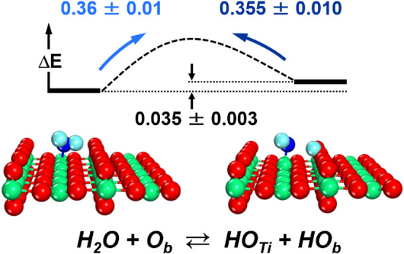

Tipping the Balance Between Molecular and Deprotonated Water on Oxide Surfaces
Scientific Achievement
Precisely measured the equilibrium between molecular and deprotonated water and the energy barriers for splitting and recombination on a prototypical titanium dioxide surface.
Significance and Impact
  Pioneering instruments and calculations ended a decades-old controversy and offer a new way to understand how bonds break on catalysts in a range of industrially important reactions including biomass fuels, carbon dioxide sequestration, and more.
Research Details
To obtain the data, the team combined a supersonic molecular beam with scanning tunneling microscopy and ab initio molecular dynamics simulations
Water incident energy measurements at different temperatures yielded the site-specific information about the population of molecular and dissociated species
Ab initio molecular dynamics trajectories revealed how an electrostatic field reorients and activates water molecule from a “long distance”
Metastable hydroxyl species are prepared on TiO₂(110) by collisions with high-energy water molecules and imaged by scanning tunneling microscopy
Detailed measurements coupled with theoretical calculations provide unprecedented level of detail about water deprotonation
Z.T. Wang, Y.G. Wang, R. Mu, Y. Yoon, A. Dahal, G.K. Schenter, V.A. Glezakou, R. Rousseau, I. Lyubinetsky, and Z. Dohnálek, PNAS. Embargo release Feb. 6th.
Notes:
For decades, scientists have argued over stability of molecular and dissociated water (whole or split molecules) on even the simplest of oxide surfaces. Oxide surfaces apply to geology, corrosion, acid/base catalysis, and much more. However, direct measurements of the relative stability of water molecules with respect to its dissociated counterparts, surface hydroxyls, and the energy needed to change states have remained elusive. In a pioneering study, researchers from Pacific Northwest National Laboratory picked one of the key water-splitting photocatalysts, titanium oxide, and obtained the first direct measure of the amount of energy needed to split the water and put it back together. To get the data, they first had to create a system that could make the desired measurements. They combined a supersonic molecular beam with scanning tunneling microscopy. With the instrument collecting data, they then had to solve a host of puzzles, including deciphering the odd way the water fragment laid on the surface. Iterating between experiments and complex calculations, the team showed that molecular water is only 0.035 eV more stable than its dissociated counterparts resolving a long-standing controversy. Using molecular dynamics simulations, the team further showed how water molecules approaching the surface break. It all begins with the long-range fields that emanate from the oxide and “orient” the water molecules so they’ll break in a specific way. The team’s technique can provide answers on other systems where bond activation is crucial, including biomass deoxygenation and carbon dioxide reduction.
-------------------------------
PI: Johannes Lercher
Project: 47319; KC0302010; Low-Temperature Catalytic Routes for Energy Carriers via Spatial and Chemical Organization
DOE Program Manager: Viviane Schwartz
Publication: Probing Equilibrium of Molecular and Deprotonated Water on TiO₂(110)
Zhi-Tao Wang, Yang-Gang Wang, Rentao Mu, Yeohoon Yoon, Arjun Dahal, Gregory K. Schenter, Vassiliki-Alexandra Glezakou, Roger Rousseau, Igor Lyubinetsky, and Zdenek Dohnálek
dx.doi.org/10.1073/pnas.1613756114 | PNAS

