Slide 1
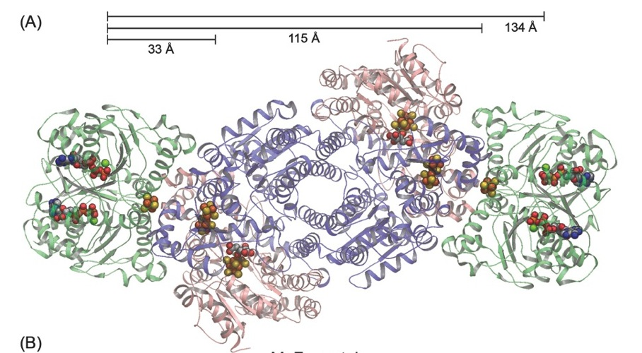
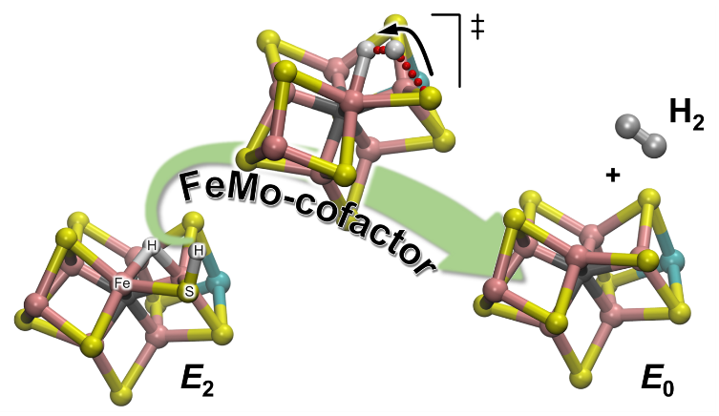
The Nitrogenase Nuance: Kinetics of nitrogenase di-hydrogen production
Scientific Achievement
Uncovered the single proton shuffle used by nitrogenase to produce H₂ in the absence of nitrogen, elucidating a key kinetic and mechanical detail of a powerful energy storage reaction
Significance and Impact
Informs how and why H₂ production is accomplished by nitrogenase and illustrates a new strategy for mechanistic study that can be applied to similar complexes
Research Details
Performed hydrogen/deuterium kinetic measurements using small molecules to shuttle electrons from an electrode to nitrogenase.
Used computational chemistry to elucidate reactions.
Discovered that a nearby H+ was the active partner in the production of H₂ when it combines with the iron-hydrides that charge the enzyme’s active site.
The nitrogenase enzymatic complex
ATP
8 e ⁻
FeMo - cofactor
N₂ + 8H⁺
2NH₃ + H₂
Hydrogen evolution from FeMo-cofactor
Khadka et al.,
JACS, 139:13518-13524. DOI: 10.1021/jacs.7b07311
Notes:
While the enzyme nitrogenase is vital to producing the nitrogen -- in the form of ammonia (NH₃) -- that winds up in proteins and nucleic acids, it’s the secondary process of producing molecular hydrogen (H₂) that scientists want to know. Understanding how H₂ is released and how it promotes NH₃ production is key for unveiling the secrets on this mysterious enzyme. Scientists have known for some time that nitrogenase makes H₂ by two different processes. Now, one of these processes is clear through the work of a team of researchers who studied the mechanism for H₂ production. The team’s use of hydrogen/deuterium inventory to study the activities at the heart of the enzyme is the first such approach to reveal the mechanism for H₂ formation by an enzyme. It thus provides crucial insights into the nitrogenase activity and serves as an example for other, similar studies.
----------------------------------------
PI: Simone Raugei
Project: 66476, KC0304020, Enzymatic energy conversion: Nitrogenase as a paradigm
DOE Program Manager: Bob Stack
Publication: Mechanism of Nitrogenase H₂ Formation by Metal-Hydride Protonation Probed by Mediated Electrocatalysis and H/D Isotope Eﬀects
Simone Raugei
dx.doi.org/10.1021/jacs.7b07311 | Journal of the American Chemical Society

