Slide 1
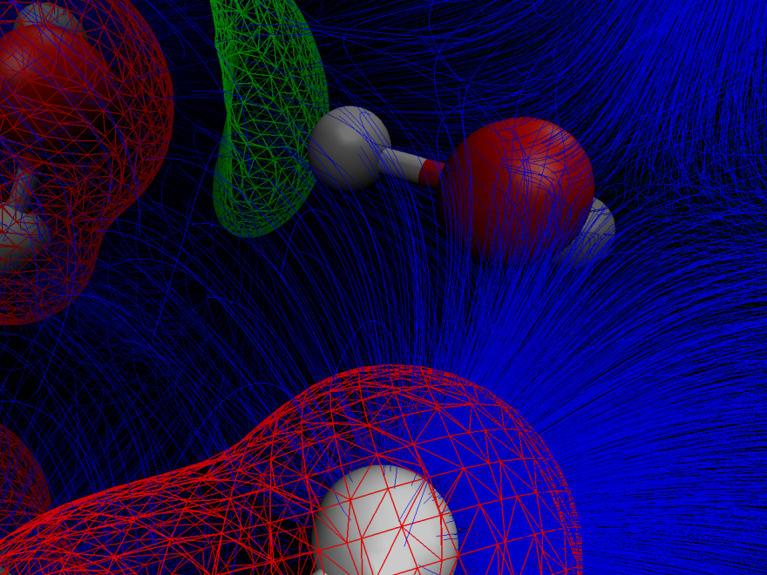
Solving Mysteries of How Water Works
Scientific Achievement
Scientists pioneered a joint experimental / theoretical approach that more precisely assigns the vibrations of hydrogen bonds in a network of water molecules and an ion
Significance and Impact
This fundamental research provides insights into the behavior of the universal solvent, a topic of scientific inquiry for 200 years; these insights could lead to breakthroughs in detecting vibrational signatures of crystallization or water under extreme conditions and can be further extended to forensics of nuclear materials
Research Details
The findings give rise to the concept of vibrational fields. With these findings, researchers can now address the extremely important question of how an ion's electric fields migrate through and distort water's vibrational network.
Researchers pioneered an approach to “see” how extremely intense local electric fields (blue curves) distort water’s OH vibrations. Water’s lone electron pairs (green) give rise to negative voltages relative to the positive voltages (red) due to the screened nuclei of water molecules as well as from the cesium ion. The coupling between these intense electric fields and the OH vibrations can be analyzed via these vibrational fields.
Wolke et al.,
J. Chem. Phys., 2016, DOI: 10.1063/1.4941285
Conrad Wolke, Joseph Fournier, Mark A. Johnson, Yale; Evangelos Miliordos, Shawn Kathmann, Sotiris Xantheas, PNNL
Notes:
Scientists have strived to unlock mysteries surrounding how a network of hydrogen bonds controls water’s behavior. Often called the universal solvent, water’s behavior affects a wide range of industries and activities. Researchers at Pacific Northwest National Laboratory and Yale University pioneered an approach that identifies how this network of bonds is structured. The team’s approach makes the assignment of vibrations of hydrogen bonds in water much more definitive. The team used a model cluster composed of six water molecules around a positively charged cesium ion to validate the approach. They found a way to isolate the response of each water molecule in the network of hydrogen bonds so that they could accurately compute the way water is deformed according to its local electric field from the surrounding environment. In essence, the team built a road map to use theoretical tools to assign the experimentally measured spectra and pinpoint the molecular motions that are vital to predicting water’s behavior in different systems.
----------------------------------------
Principal Investigators: Sortiris Xantheas and Shawn Kathmann
Project: 16249, KC0301050, Molecular Theory and Modeling
DOE Program Manager: Greg Fiechtner
Publication: Isotopomer-selective spectra of a single intact H₂O molecule in the Cs⁺(D₂O)₅H₂O isotopologue: Going beyond pattern recognition to harvest the structural information encoded in vibrational spectra
Evangelos Miliordos, Shawn Kathmann, Sotiris Xantheas
dx.doi.org/10.1063/1.4941285 | J. Chem. Phys.

