Slide 1
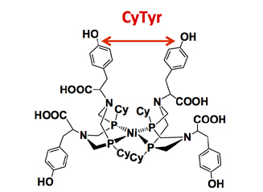
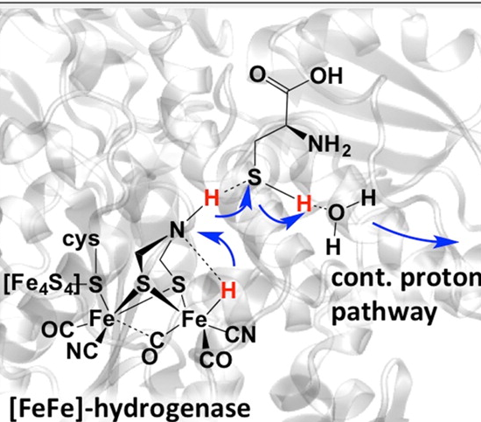

Reversible Catalyst Operates Without Added Energy,
Resolving Key Scientific Challenge of Interest for Renewable Power
Scientific Achievement
  Created a catalyst that mimics natural hydrogen-splitting enzymes—operates reversibly at room temperature and pressure without added energy
  Significance and Impact
  Turning solar and wind energy into fuels would allow a different energy infrastructure. Creating and using such fuels requires a fast, efficient catalyst. The team’s design solves a key problem; it operates reversibly with minimal energy added
  Research Details
  Redesigned the periphery of a nickel-based catalyst, creating a proton path with an added a layer of amino acids to control the active site structure.
  Reversibility occurred because of interactions between the phenyl rings in the amino acid stabilized the desired conformation and the proton path, helping to move the protons along the path and alter the active site to achieve maximum efficiency.
Interactions between the rings on the phenylalanine (inset) alter the nickel active site. The catalyst functions with the same efficiency and relative pathway as the natural enzyme (larger image).
Priyadarshani et al., ACS Catalysis, 2016,
DOI: 10.1021/acscatal.6b01433
Nilusha Priyadarshani, Arnab Dutta, Bojana Ginovska, Garry W. Buchko, Molly O’Hagan, Simone Raugei, and Wendy J. Shaw, PNNL
Notes:
Using solar energy to create fuel would harvest that energy for dark or stormy days. The challenge is creating the right catalyst. It must control the reactions to produce a fuel, such as hydrogen, and later break the fuel to release the energy. Microbes do this every day via enzymes. Scientists at Pacific Northwest National Laboratory built a catalyst that mimics nature’s hydrogen-splitting enzymes. The catalyst works reversibly at room temperature and pressure without added energy. The team stabilized the catalyst’s structure by attaching an amino acid that created outer scaffolding interactions; they also controlled protons’ movement. The catalyst has the highest possible efficiency, but it is not as fast as the fastest enzymes. Building on what they have learned and using additional outer coordination sphere features, a faster catalyst that is also reversible should be achievable.
----------------------------------------
PI: Johannes Lercher
Project: 47319; KC0302010; Low-Temperature Catalytic Routes for Energy Carriers via Spatial and Chemical Organization
DOE Program Manager: Viviane Schwartz
Publication: Achieving Reversible H₂/H⁺ Interconversion at Room Temperature with Enzyme-Inspired Molecular Complexes: A Mechanistic Study
Nilusha Priyadarshani, Arnab Dutta, Bojana Ginovska, Garry W. Buchko, Molly O’Hagan, Simone Raugei, and Wendy J. Shaw
dx.doi.org/10.1021/acscatal.6b01433 | ACS Catalysis

