Slide 1
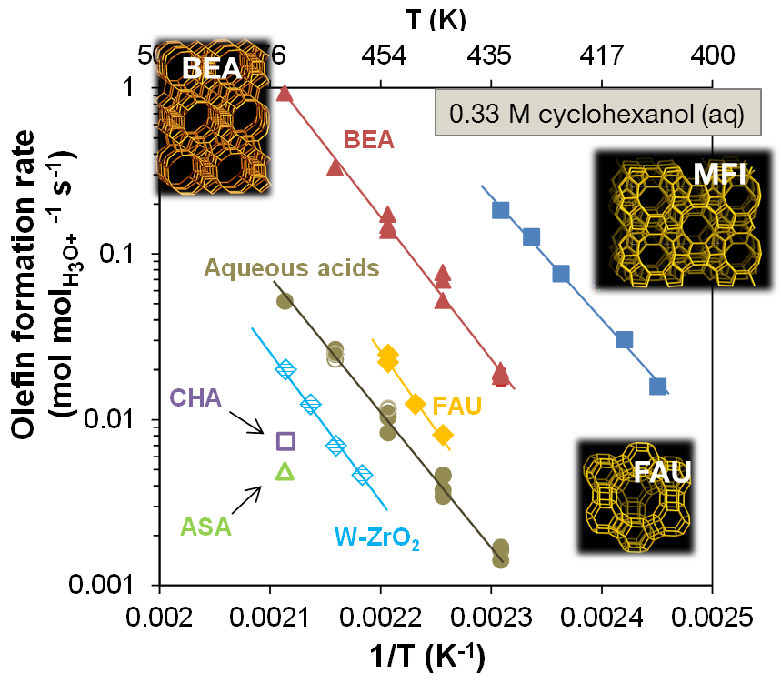
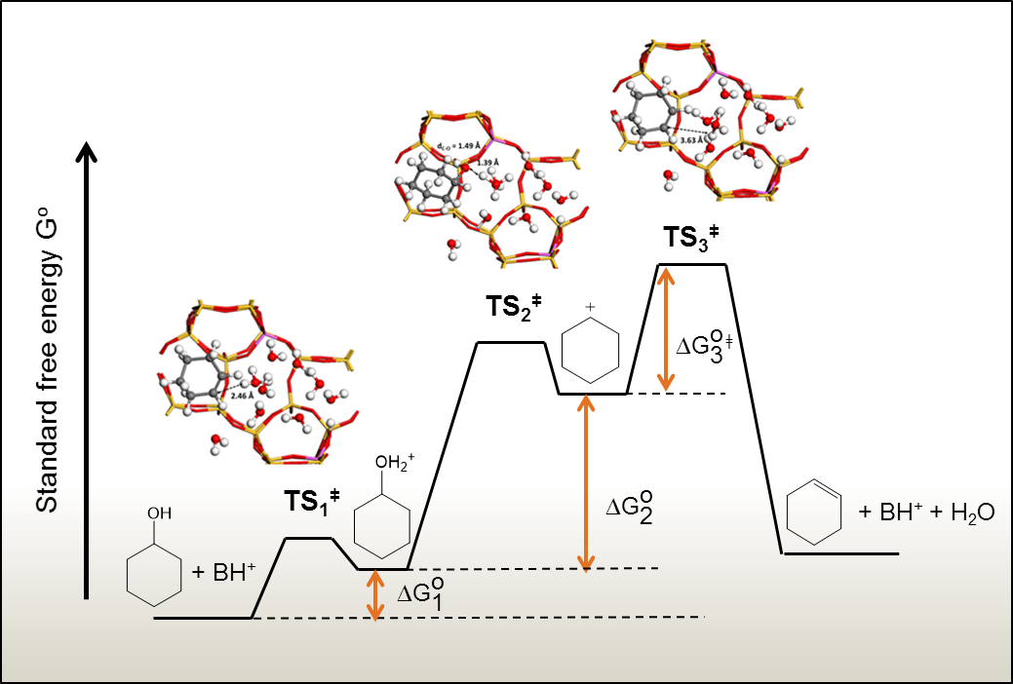


Manipulating Elimination Pathways via Constraints
Scientific Achievement
Confining hydronium ions in sub-nanometer pores enhances alcohol dehydration.
Significance and Impact
  Design principles for inorganic materials that combine enzyme-like activities with robustness under harsh environments.
Research Details
  Catalysis in zeolite pores and in solution elucidated using rigorous kinetic methods combined with nuclear magnetic resonance (NMR) spectroscopy, liquid phase calorimetry and theory.
  Rate enhancements in zeolites are due to favorable thermodynamics for adsorption of alcohols and enthalpy-entropy compensation in their activation parameters.
  Isotope labeling experiments and theoretical simulations show the hydronium ion catalyzed dehydration of cyclohexanol occurs via an E1 mechanism with the cleavage of Cβ–H bond being rate-determining.
Aqueous phase
Top: Confining catalytically active hydronium ions inside zeolite catalysts enhances the rate of alcohol dehydration to hydrocarbons up to 100 times faster. Bottom: Theoretical simulations show the hydronium ion catalyzed the elimination of water via the E1 mechanism.
Y. Liu, et al., Nat. Comm., 2017, DOI: 10.1038/ncomms14113 ✦ H. Shi, et al. Nat. Comm., 2017, DOI: 10.1038/ncomms15442
Notes:
Shipping organic waste to biorefineries over distances longer than 50 miles is costly and inefficient. Therefore, local decentralized conversion processes operating at lower than conventional temperatures are needed. The critical steps are related to the deconstruction of the organic waste, as well as to the elimination of oxygen from the intermediates by acid-base catalysis. This study provided a new approach to boost the reaction rates, showing a conceptual design to mitigate a critical step towards realizing decentralized fuel production. The solution was forcing a key reaction to occur in the nano-sized confining pores inside zeolites. The new approach boosts the reaction rates.
----------------------------------------
PI: Johannes Lercher
Project: 47319, KC0302010, Low-Temperature Catalytic Routes for Energy Carriers via Spatial and Chemical Organization
DOE Program Manager: Raul Miranda
Publication: Enhancing the catalytic activity of hydronium ions through constrained environments
Publication: Tailoring nanoscopic confines to maximize catalytic activity of hydronium ions
Yuanshuai Liu, Sebastian Eckstein, and Eszter Baráth, TU München; Aleksei Vjunov, Hui Shi, Donald M. Camaioni, Donghai Mei, Pacific Northwest National Laboratory; Johannes A. Lercher, TU München and Pacific Northwest National Laboratory
dx.doi.org/10.1038/ncomms14113 | Nature Communications
dx.doi.org/10.1038/ncomms15442 | Nature Communications

