Slide 1
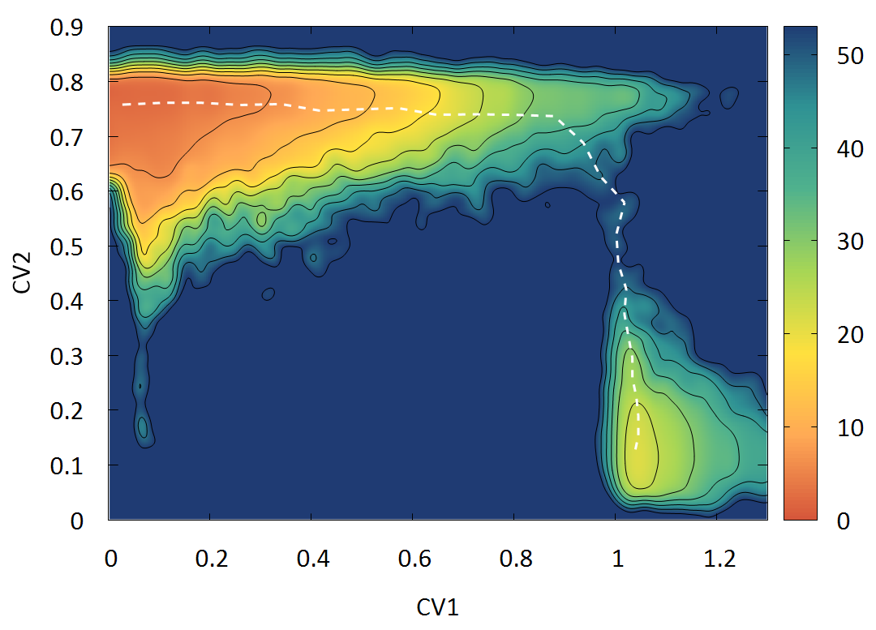
Collective Phenomena Strongly Influence Molecular Reactions
Scientific Achievement
By studying the formation of carbonic acid in gaseous, aqueous, and supercritical CO₂ reaction phases from its constituent molecules H₂O and CO₂, a detailed picture emerged of the enthalpic and entropic drivers that govern ubiquitous reactions and showed how the environment (solvent) influences reaction paths.
Significance and Impact
New understanding informs how collective motions, and their correct representation in terms of collective variables, determine reaction paths.
Research Details
Theory and simulation revealed details of the subtleties ensuing from both local and long-range energy fluctuations.
Statistical mechanical techniques enabled tracking of energy aliquots to specific reactions and intermediates.
The choice of the collective variables that well represent the reaction environment are crucial in describing and computing the free energy landscape.
Research featured on the cover of the Journal of Physical Chemistry revealed detailed pathways that drive molecular reactions in gaseous, aqueous, and supercritical CO₂ phases.
Daniela Polino, Emanuele Grifoni, Roger Rousseau, Michele Parrinello, and Vassiliki-Alexandra Glezakou
The Journal of Physical Chemistry A 2020 124 (20), 3963-3975 (feature article) DOI: 10.1021/acs.jpca.9b11744
Work was performed at PNNL, NERSC, ETH Zurich, the Università della Svizzera Italiana, and the Swiss National Supercomputing Center.
Notes:
Due to the role of CO₂ in the greenhouse effect and environmental management, its reaction with water has been studied extensively. But the same cannot be said for reactivity in the supercritical CO₂ (scCO₂) phase. In this phase, conjugate acid/base equilibria proceed through different mechanisms and encounter different activation barriers.
Scientific collaborators from Pacific Northwest National Laboratory and ETH Zurich in Switzerland found that despite the apparent simplicity of the CO₂ + H₂O reaction, collective motions in the reaction environment had a drastic influence on the free energy profile in various phases. The resulting detailed picture of enthalpic and entropic drivers underscores the differences in the formation mechanism of carbonic acid in the gaseous, aqueous, and supercritical CO₂ phases. The researchers believe theirs is the first comprehensive study to compare the fundamental reactivity of CO₂ and H₂O in these distinct environments.
To examine the factors that influence entropy or enthalpy phenomena, the team combined theory and simulation with enhanced sampling, or metadynamics. These complicated but important statistical and mechanical techniques allowed tracking of energy aliquots among collective variables through iterative simulations. This approach accounted for the conformational and configurational complexity of the solvent media as well as the potential side reactions related to reactants and products. The resulting detailed picture of the overall reactive landscape revealed novel insights into solvent effects and unanticipated reactivity, which hold important implications for efficiencies in applications such as separations, catalysis, and carbon remediation.
PI: Vanda Glezakou Project #: 47319 Title:, Transdisciplinary Approaches to Realize Novel Catalytic Pathways to Energy Carriers Program Coordinator: Johannes Lercher DOE Program Manager(s): Raul Miranda, Viviane Schwartz, Chris Bradley, Dan Matuszak. Research sponsored by BES Catalysis (RR and VAG co-PIs). Dan Matuszak added because structure and dynamics at interfaces is also very relevant to project 72353 Interfacial Structure and Dynamics in Ion Separations (theory lead VAG).
Publication Title: How Collective Phenomena Impact CO₂ Reactivity and Speciation in Different Media Publication Reference: Daniela Polino, Emanuele Grifoni, Roger Rousseau, Michele Parrinello, and Vassiliki-Alexandra Glezakou
The Journal of Physical Chemistry A 2020 124 (20), 3963-3975
DOI: 10.1021/acs.jpca.9b11744

