Slide 1
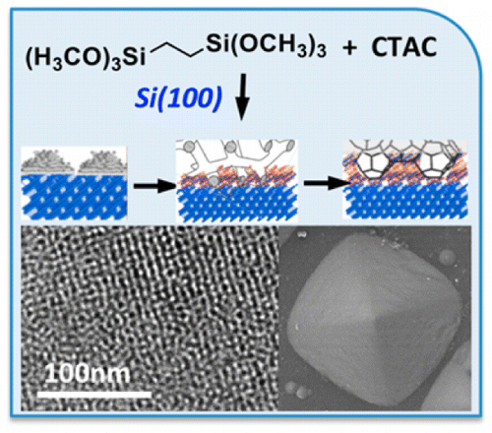
Dual Lattice Matching Offers New Pathway for Ordered Porous Materials Synthesis
Scientific Achievement
Discovered that atomic ordering of the substrate can direct formation of a soft template and lattice-matching of an inorganic phase to produce highly ordered materials with cubic arrays of nanopores
Significance and Impact
Offers new paradigm in knowledge-based one-step synthesis of highly ordered three-dimensional porous materials for practical applications in catalysis, energy conversion and storage
Research Details
The silicon substrate directs the self-assembly of the molecular template along a specific crystallographic direction
This template then directs the formation of sodium silicate along the same crystallographic direction of the substrate ensuring near-perfect lattice matching between silicon and sodium silicate
After a series of transformations of the organic template, it forms an array of well-defined spherical micelles several nanometers in diameter, arranged in a cubic lattice and encapsulated into the sodium silicate
Highly ordered sodium silicate particles with a regular array of spherical pores are formed on a silicon surface. The one-step synthesis is directed by the atomic ordering of the substrate, which induces the formation of a soft template for sodium silicate growth. Sodium silicate, in turn, modifies the structure of the soft template during growth, encapsulating it within its structure.
Shin et al.,
ACS Nano , 2016, 10, 8670-8675.
Yongsoon Shin, Jinhui Tao, Bruce Arey, Chongmin Wang, Greg Exarhos, Jim De Yoreo, Maria Sushko, Jun Liu, PNNL

