Slide 1
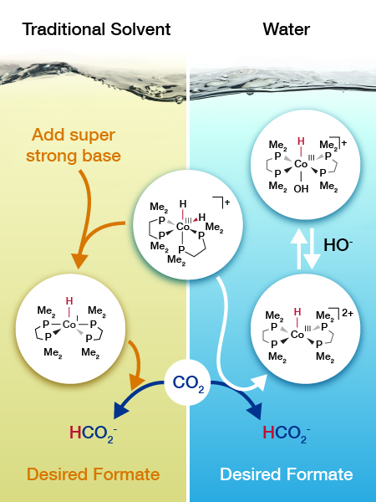

Changing the Surroundings Improves Catalyst
Scientific Achievement
  A cobalt catalyst turns carbon dioxide into a building block for fuel in water, eliminating the need for a costly, super strong reactant.
  Significance and Impact
  Understanding the influence of the reaction environment is vital to designing the best catalysts. This study shows the solvent can be used to control the catalytic mechanism.
  Research Details
  Predicted how the catalyst would react with carbon dioxide based on the expected impact of solvent on hydride (H–) transfer
  The mechanism in water was different from that occurring in a traditional solvent, tetrahydrofuran
  Catalysis in water relies on inexpensive sodium bicarbonate instead of a strong and expensive base
  The catalyst is the most active nonprecious metal catalyst that operates in water
Researchers determined that the cobalt catalyst (center) takes a different path for converting carbon dioxide depending on the solvent.
SA Burgess, AM Appel, JC Linehan, ES Wiedner,
Angew. Chem. Int. Ed. 2017, 56, 15002-15005.
DOI: 10.1002/anie.201709319
Notes:
Turning carbon dioxide into a building block for fuels demands a catalyst system that can drive the reaction without costly chemicals. A team at Pacific Northwest National Laboratory devised a cobalt-based catalyst system that meets the need. The catalyst works in water without relying on precious metals or expensive bases. The team developed the catalyst by first predicting how the catalyst would react with carbon dioxide in water. The mechanism was different from those occurring in the traditional solvent, tetrahydrofuran. This catalysis in water relies on inexpensive sodium bicarbonate (baking soda) instead of a strong and expensive base. Guided by the predictions, the team synthesized and tested the catalyst. They characterized the catalyst with high-pressure nuclear magnetic resonance spectroscopy using a special cell designed and built at PNNL. The team’s analysis showed that the catalyst worked as predicted.
----------------------------------------
PI: Johannes Lercher
Project: 47319, KC0302010, Low-Temperature Catalytic Routes for Energy Carriers via Spatial and Chemical Organization
DOE Program Manager: Viviane Schwartz
Publication: Changing the Mechanism for CO₂ Hydrogenation Using Solvent-Dependent Thermodynamics
Samantha A. Burgess, Aaron M. Appel, John C. Linehan, and Eric S. Wiedner
dx.doi.org/10.1002/anie.201709319 | Angewandte Chemie International Edition

