Slide 1
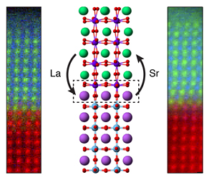
Atoms Depart When Oxides Meet
Scientific Achievement
Directly imaged the loss of a single atomic layer in a photocatalyst created by layering two oxides; showed the starting material's surface is unstable and can dramatically reconfigure.
Significance and Impact
Design synthesis methods to account for growth dynamics and the atomic restructuring; could lead to more precise control of key energy materials.
Research Details
Examined thin film lanthanum iron oxide and strontium titanium oxide, LaFeO₃ (LFO) and SrTiO₃ (STO), respectively, layered together to produce a photocatalyst for solar water splitting
Treated the STO layer to cap it with either a strontium oxide (SrO) plane or a titanium dioxide (TiO₂) plane.
Deposited an LFO layer atop the STO.
Discovered that both samples had a TiO₂ interface plane and that the SrO layer had gone missing during synthesis.
Conducted calculations for different atomic configurations of the interface, finding that the SrO layer was less stable than TiO₂ and that it could be lost by forming oxygen vacancies.
Chemical mapping and illustration of atomic rearrangement at the interface between two oxide materials (La = lanthanum; Sr = strontium).
Spurgeon et al., Physical Review Materials 2017. DOI: 10.1103/PhysRevMaterials.1.063401

