Slide 1
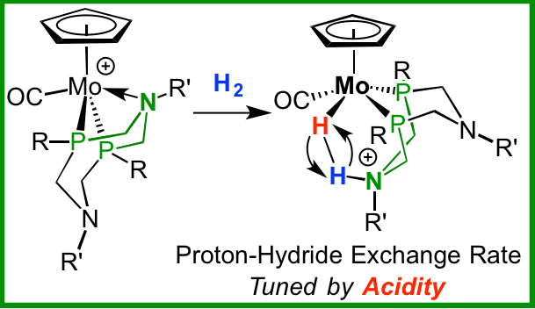
A Molecule Made to be Broken
Scientific Achievement
Achieved control over the rate of cleavage and reassembly of a dihydrogen molecule, demonstrating control over catalytic behavior
Significance and Impact
Elucidated the properties of heterolytic dihydrogen bond cleavage and how to control the location and energy of the resulting proton and hydride; offers insights for the design of effective catalysts for energy production, generation, and use
Research Details
Created a series of molybdenum-based (Mo) catalysts, for which the rate of H-H cleavage and reassembly could be systematically varied
Controlled the rate of cleavage by systematically changing the electronic characteristics of the metal complexes. Some of these bonds are cleaving and reassembling at close to 10 million times a second at room temperature. By changing the acidity of these complexes, the reversible heterolytic cleavage rate can be changed by a factor of 10,000.
The molybdenum-based catalyst was generated in situ by hydride abstraction from n fluorobenzene.
S Zhang et al.,
Journal of the American Chemical Society , 2017, DOI: 10.1021/jacs.7b03053
Shaoguang Zhang, Aaron M. Appel, and R. Morris Bullock
Notes:
The dihydrogen molecule, with a hydrogen-hydrogen bond, is one of the simplest and most flexible in chemistry. Cleaving a dihydrogen bond requires the perfect balance of design of catalyst properties to achieve the desired reactivity. Morris Bullock and his colleagues at Pacific Northwest National Laboratory achieved control over the rate of cleavage and reassembly of a dihydrogen molecule, furthering their understanding of catalyst design.
---------------
PI: Johannes Lercher
Project: 47319, KC0302010, Low-Temperature Catalytic Routes for Energy Carriers via Spatial and Chemical Organization
DOE Program Manager: Viviane Schwartz
Publication: Reversible Heterolytic Cleavage of the H–H Bond by Molybdenum Complexes: Controlling the Dynamics of Exchange Between Proton and Hydride
Shaoguang Zhang, Aaron M. Appel, and R. Morris Bullock
dx.doi.org/10.1021/jacs.7b03053 | Journal of the American Chemical Society

