Slide 1
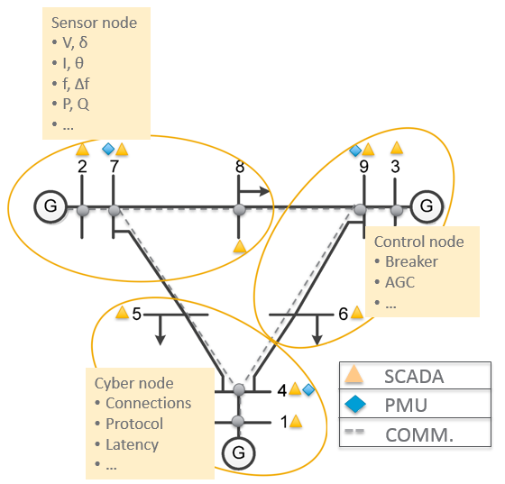






PowerDrone: Adaptive Steering of Power Systems for Resilient Operation under Adversarial Conditions
Sutanay Choudhury, Seemita Pal, Sai Pushpak Nandanoori, Khushbu Agarwal, Soumya Kundu
Motivation
Technical Approach
Power grid is one of the most critical infrastructures and attractive target for nation-state actors, disgruntled insiders or casual hackers
Reasoning about how potential adversarial scenarios affect the stability of power grid is important
We propose a graph-ML approach that detects change in system-level properties from increased observations (such as PMU, SCADA, and cyber data) and steers the system to stability using adaptive controls
Input Data
Detection
Adversarial Scenario
State of the
art
Drawbacks
Proposed
Physical Layer: Topology, configuration
Sensor Layer: PMU, SCADA
Communication Layer: Configuration, protocols, packet sizes, latencies etc.
Sensor Layer: Detection of adversarial scenarios
Communication Layer: Locate compromised neighborhood
Physical topology or load changes
AGC control based on SCADA measurements
Current AGC control is based on SCADA (does not capture system dynamics)
RL based control considering PMU measurements
Data Integrity attacks (Ramp attack, step attack)
AGC control based on SCADA measurements with human in the loop
Need human to make the decision whether to apply AGC or not
RL based control considering PMU measurements (that isolates compromised sensor data)
Mitigation
Control
Our Objective
Physical Layer: Change in generation
Communication Layer: Switching for route change
Control Layer: Control signals for AGC
Communication Layer: Configuration change commands
Design and develop prototype for detection and mitigation of adversarial scenarios
Red Team: Simulates adversarial actions that can impact the physical system
Blue Team: Detects adversarial conditions and steers system to safety based on RL-based mitigation strategies
System: CPS model integrated with red and blue team modules for evaluating performance under various adversarial-defensive scenarios
Cyber-physical system
$$\hat{y}$$
A1
Networking issues (latency, packet drops)
Designing an observer and delay aware or robust AGC control based on SCADA measurements
Needs design of an observer and design of delay aware or robust AGC control
RL based control considering PMU measurements (that is robust to delay or packet drops)
Red Team
A4
PMU data
CPS system with PMU measurements and AGC signals
Adversarial
scenarios
Control
signals
Controller
A2
Cyber-Physical System with Sensors
A3
$$\hat{u}$$
Technical Accomplishments
Adaptive
steering
Simulation study: IEEE 68 bus system: 16 generators, two areas connected through three tie-lines
Blue Team
Ramp attack on PMUs located at bus # 10, 56
Attack started at 3 sec and lasted until 12 sec
Attack magnitude: 5% deviation from nominal
Significance and Impact
Determine impact of data integrity, data availability, and delay injection attacks on dynamics of AGC-dependent system
Identification of metrics for evaluation of red team and blue team actions
Detection and mitigation of adversarial scenarios for adaptive steering of the grid towards stability
AGC is implemented based on compromised PMU measurements
Causes frequency and voltage deviations
Opportunities - New or Expanded Areas
Acknowledgements and Contacts
We would like to thank the AGM program and Alireza Ghassemian for supporting this project.
Sutanay Choudhury
Pacific Northwest National Laboratory
P.O. Box 999, MS-IN: J4-33
Richland, WA 99352
(509) 375-3978
sutanay.choudhury@pnnl.gov
Developing a cyber-physical security based use case for DOE's Exascale Computing
Inclusion of more types of adversarial scenarios (including game-theoretic based) in the red team module
ML-based detection strategies in the blue team module
Integration of SDN-based switching control in the communication layer
File Name // File Date // PNNL-SA-#####
Department of Energy (DOE) Office of Electricity (OE) Advanced Grid Modeling (AGM) Program Peer Review Meeting
Notes:
NOTE: Print this poster file at 100% SCALE to result in a physical print measuring 36” wide x 36” tall. All type size notations shown above are based on the final printed size of the poster.
• Contact Digital Duplicating (375-2969, http://digitalduplicating.pnl.gov) to order poster printing and finishing services for your completed poster design.
• Remember to have your poster cleared for public display/distribution through the Information Release system (http://informationrelease.pnl.gov).
• Sidebar “About PNNL” box is considered optional, and can be removed if space is needed for technical content.

