Slide 1
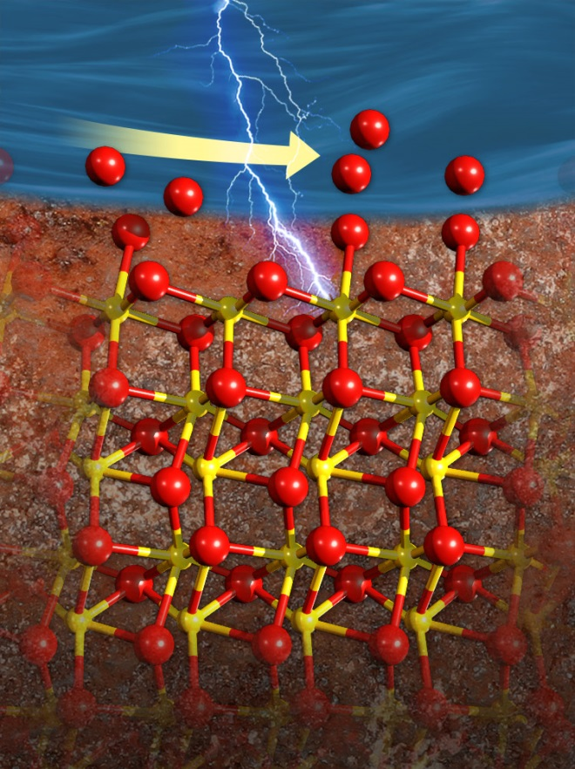
Atoms Rearrange in Electrolyte and Control Ion Flow under Tough Conditions
Scientific Achievement
First atomic-level view of dynamic changes at water-mineral interfaces far from equilibrium offers insights into how atoms rearrange to form structures that control electrical charge flow.
Significance and Impact
The research done with the new technique is essential to understanding how minerals dissolve, which underlies groundwater quality, energy extraction, and solar water splitting.
Research Details
Determined how the atoms at the hematite surface and water molecules nearby responded to incrementally increasing electrochemical bias at the interface
Flow of electrical charge and ions are controlled by the new steady-state structure while the interface is charged
Stronger binding of water molecules at the surface might explain why hematite dissolves more slowly than predicted
The interface between iron-rich hematite (bottom) and water (top) changes as the surface becomes electrically charged. Oxygen atoms (large red balls) in water molecules re-arrange near the surface, filling surface sites where adsorbed water molecules were missing.
ME McBriarty et al.,
Advanced Functional Materials, 2017,
DOI: 10.1002/adfm.201705618
Martin McBriarty, Kevin Rosso, PNNL
Joanne Stubbs and Peter Eng, University of Chicago
Notes:
The minerals that make up rocks and soils are often out of equilibrium with their surroundings, especially as environmental conditions change. Minerals respond by dissolving, growing, or transferring charge with their environment. These processes are influenced by the atomic-scale structure at their interface with water. Often, the only way to study these structures is when the interface is not changing. Now, researchers at DOE’s Pacific Northwest National Laboratory and the University of Chicago obtained the first 3-D view of the atomic structure at the interface of water and the mineral hematite while the hematite is acting as an electrode. The team saw how the atoms at the hematite surface and water molecules nearby responded to far-from-equilibrium conditions caused by electrically charging the interface. When the surface was negatively charged, some water molecules became stuck to the surface, while other water molecules became disordered and moved away from the surface. What do these structural changes mean? The flow of electrical charge and ions are controlled by the structure while the interface is charged, and the stronger binding of water molecules at the surface might explain why hematite dissolves more slowly than predicted. The team’s approach to solving these far-from-equilibrium structures could be used to study other interfaces. This is the first systematic study of the atomic- to nano-scale structure of a common mineral-water interface poised far from equilibrium. It’s a major advance in learning how to accurately model reactions vital to everything from groundwater quality, to energy extraction from the subsurface, to solar water splitting.
----------------------------------------
PI: Kevin M. Rosso
Project: 56674, KC0302060, Molecular Mechanisms of Interfacial Reactivity in Near Surface and Extreme Geochemical Environments
DOE Program Manager: Jim Rustad
Publication: Potential-specific structure at the hematite-electrolyte interface
Martin McBriarty and Kevin Rosso, Pacific Northwest National Laboratory; Joanne Stubbs and Peter Eng, University of Chicago dx.doi.org/10.1002/adfm.201705618 | Advanced Functional Materials

