Slide 1
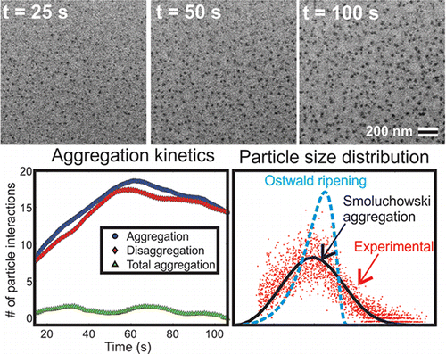



Nanoparticle Growth Dominated by Aggregation at the Mesoscale
Scientific Achievement
  Demonstrated that individual silver nanoparticles grow by monomer attachment but ensembles grow via aggregation, shedding light on previously unexplained observations of aggregative nanoparticle growth
  Significance and Impact
  Shifted long-held scientific paradigm that did not consider kinetic models to quantitatively model ensemble properties of nanoparticles where significant aggregation or other non-classical growth
  mechanisms were observed
  Research Details
  We demonstrate that the Smoluchowski model quantitatively captures the mean growth rate and particle size distribution of ensembles in better agreement than the traditional Ostwald ripening
  New quantitative imaging approach involved directly observing solution-phase nanoparticle growth using in situ fluid stage scanning transmission electron microscopy and tracking both individual nanoparticle and population growth
The Smoluchowski model quantitatively captures the mean growth rate and particle size distribution, while the Ostwald ripening does not.
Woehl et al., Nano Letters, 2014, 14, 373-378.
Taylor J. Woehl and William D. Ristenpart, University of California, Davis; Nigel D. Browning, James E. Evans, and Ilke Arslan, Pacific Northwest National Laboratory; and Chiwoo Park, Florida State University

